Slide 1
ICC-Profile Introduction
Specification - ICC.1:2010 (Profile version 4.3.0.0)

Slide 2
What is ICC-Profile
ICC - International Color Consortium
CIE - Commission Internationale de l´Eclairage (国际照明委员会, International Commission on illumination)

Slide 3
What does ICC-Profile do?
colour management transform
Keep color real, by transferring different device color to CIE color
Sample: RGB color(monitor) -> CIE color -> CMYK color(printer)

Slide 4
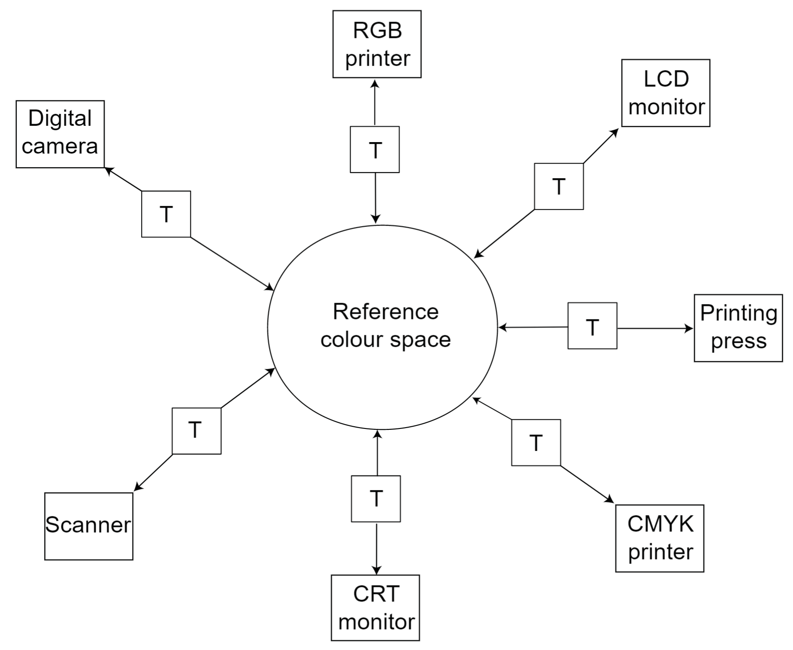
Use for colour management transform: Printer Scanner Monitor Camera

Slide 5
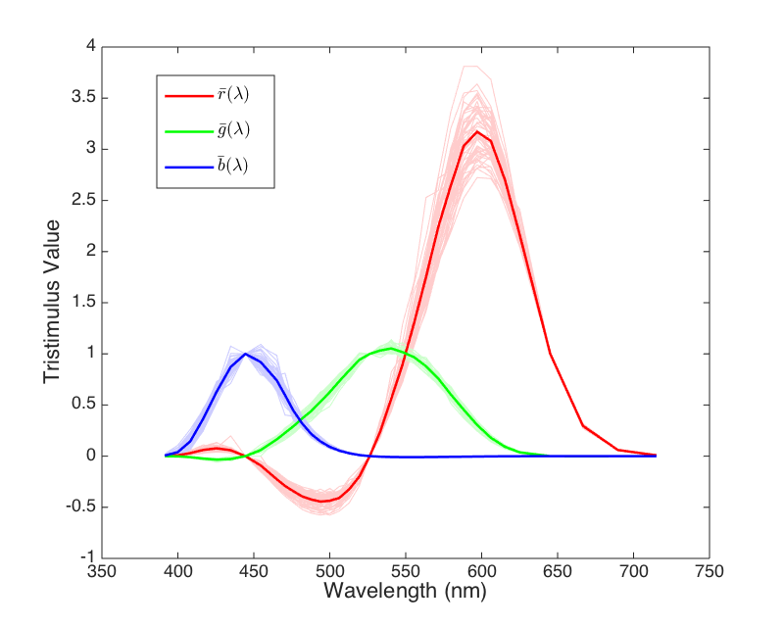
CIE Color & RGB Color

Slide 6
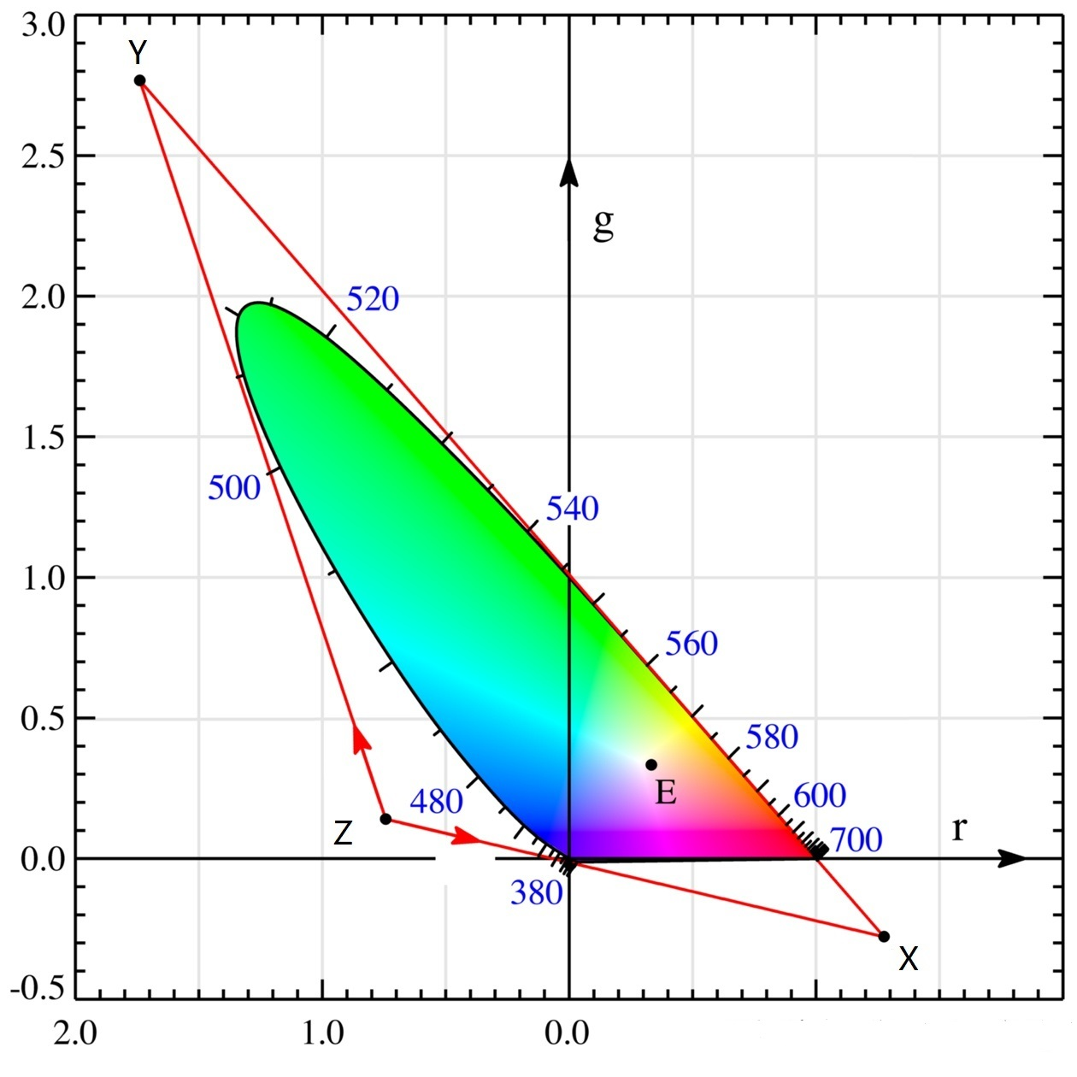
CIE Color & RGB Color

Slide 7
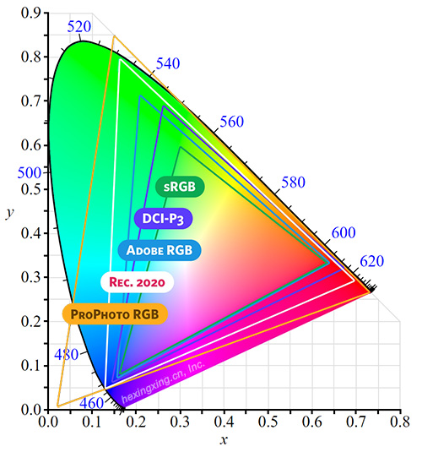
CIE Color & RGB Color

Slide 8
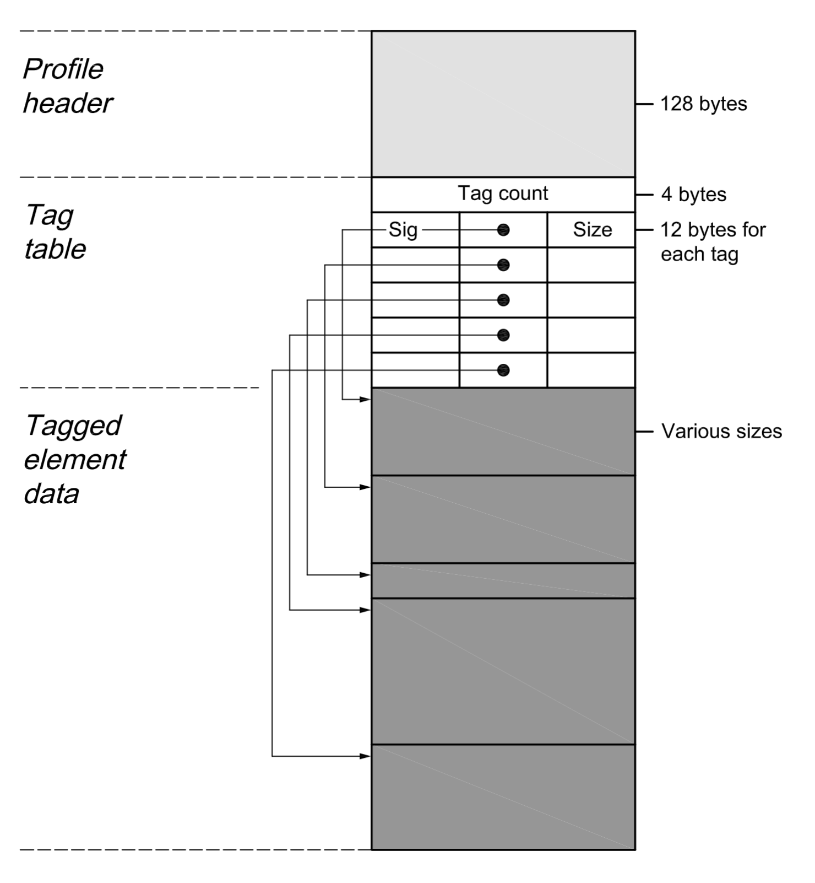
Overview structure of the ICC-Profile: Header, Tag table, Tagged data,

Slide 9
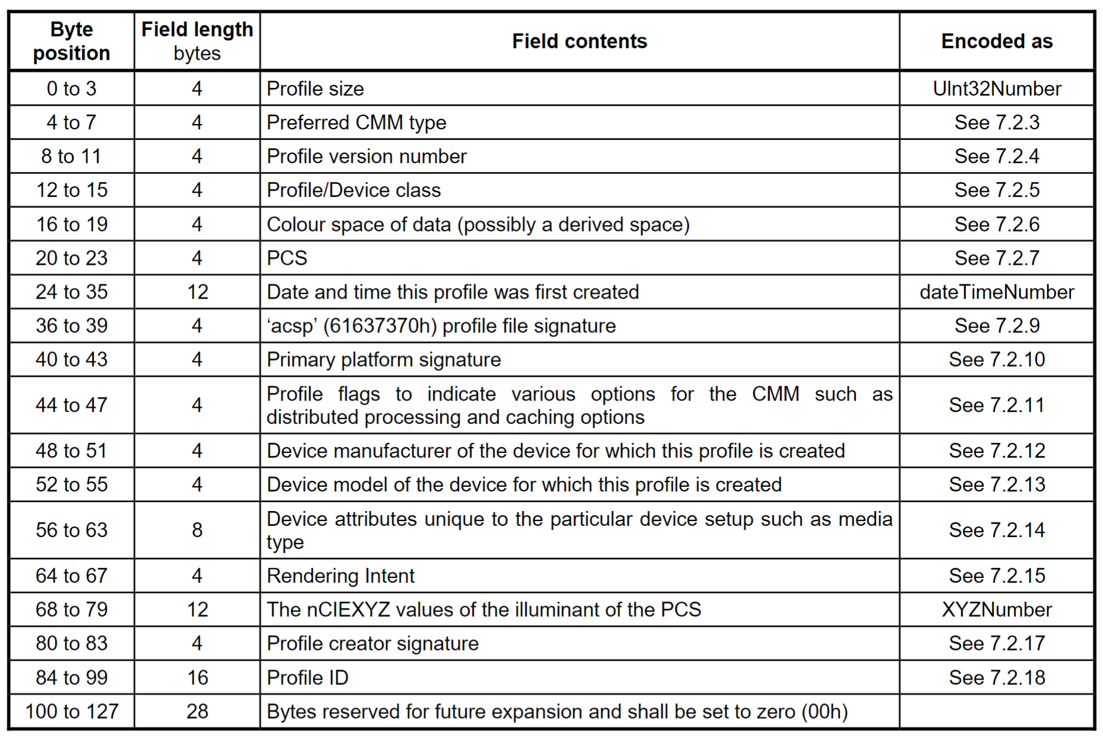
Header

Slide 10
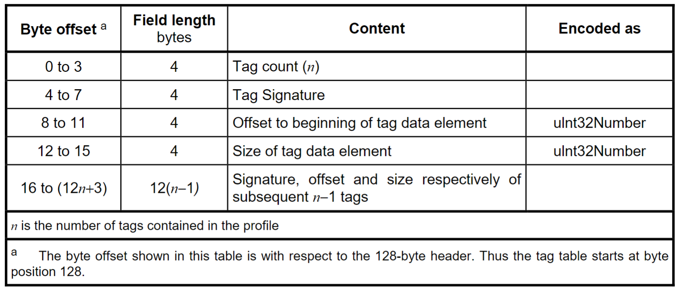
Tag table

Slide 11
Tag list
rgbXYZ:
rgbTRC: tone reproduction curve 色调再现曲线
chad: chromatic adaptation matrix (3x3) 颜色适应矩阵
dmnd: describes the structure containing invariant and localizable versions of the device manufacturer for display
lumi: luminance (Y valid, XZ set to 0)

Slide 12
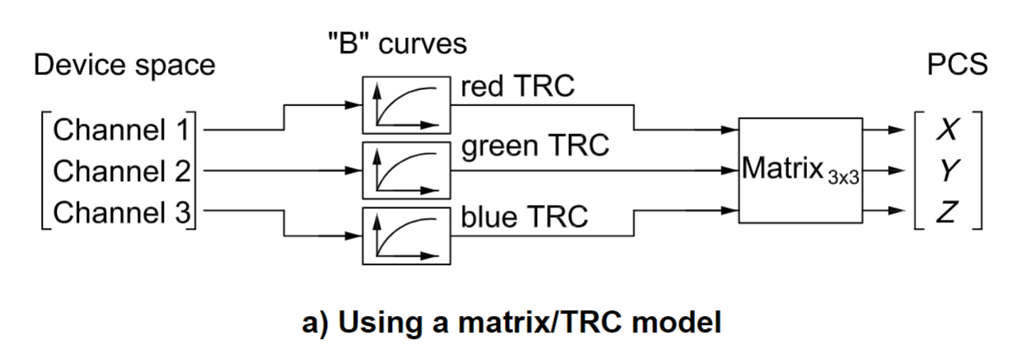
Matrix/TRC (RGB->XYZ)

Slide 13
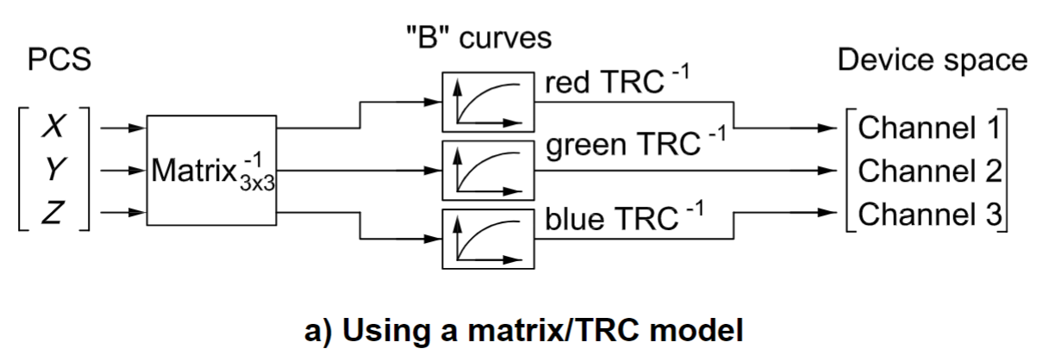
Matrix/TRC (XYZ->RGB)

Slide 14
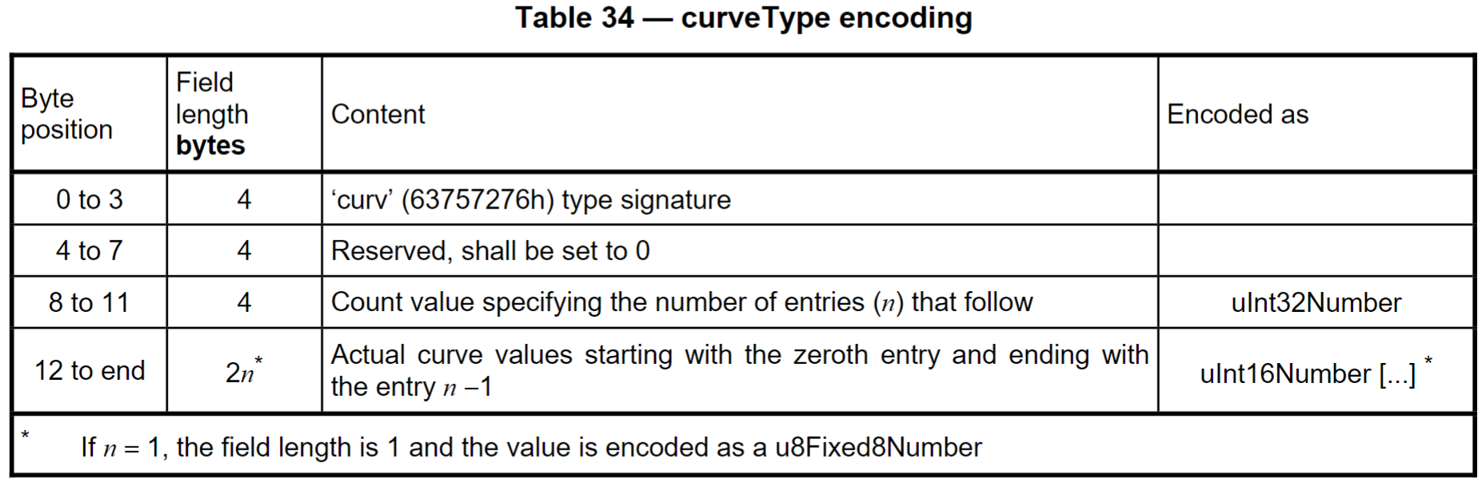
Tag type: CurveType (use in rgbTRC)

Slide 15
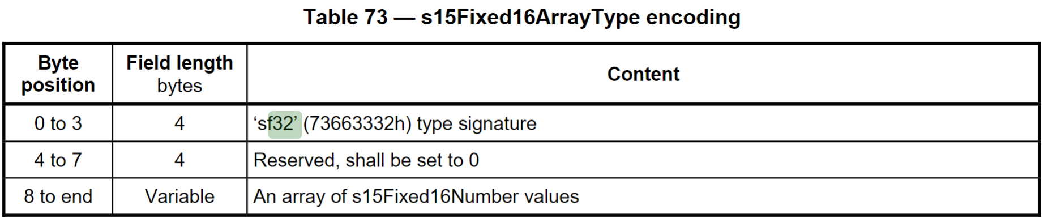
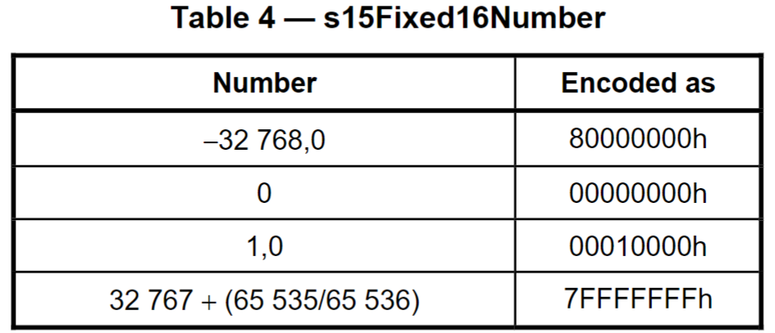
Tag type: sf32 (use in chad)

Slide 16
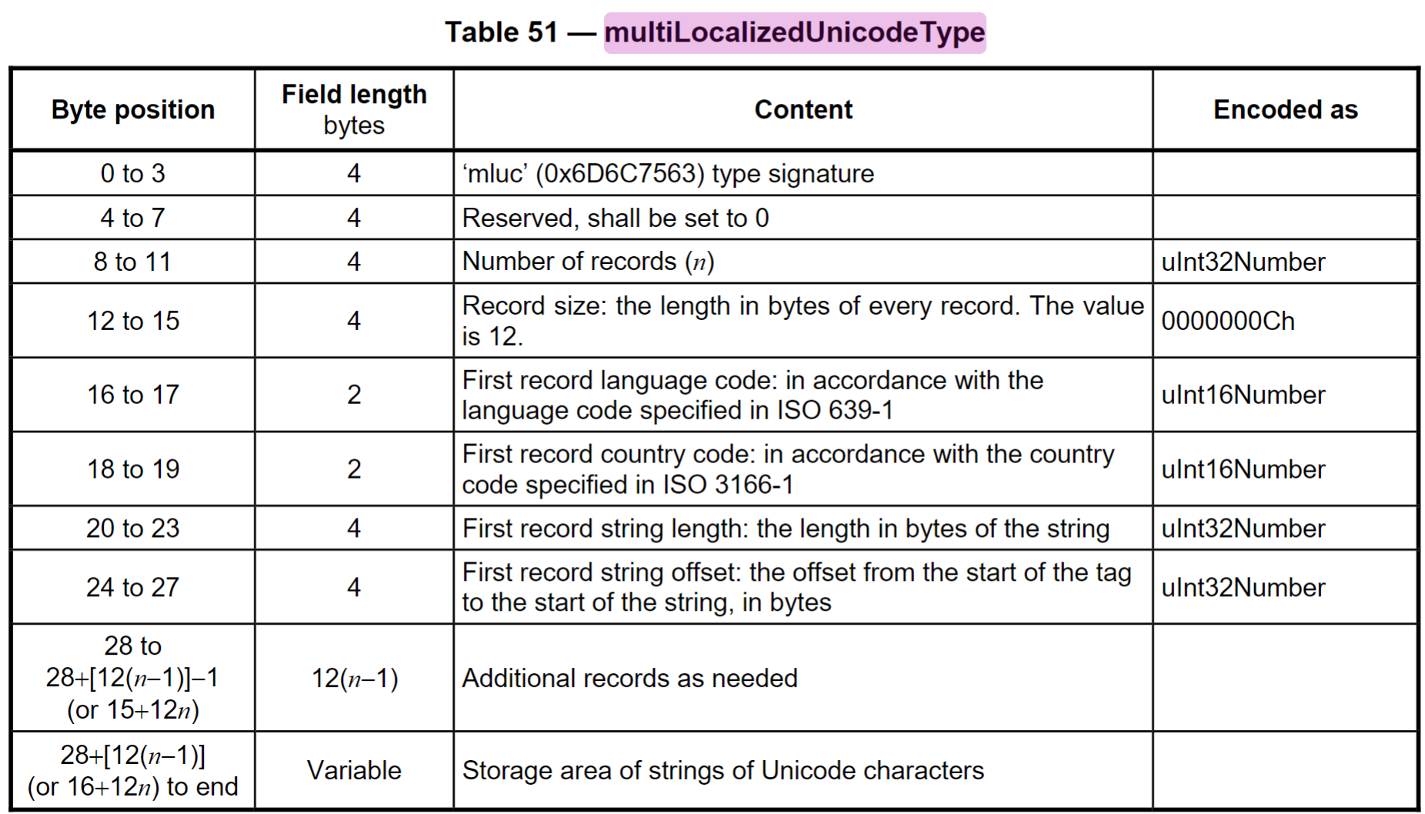
Tag type: multiLocalizedUnicodeType(dmnd)

Slide 17
Sampe: SE2722HR
Dell Desktop Monitor
SE2722HR.icm
D65

Slide 18
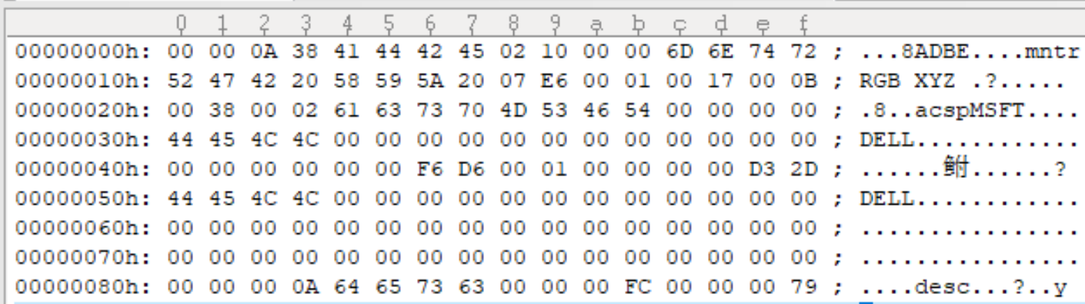
Sampe: SE2722HR Header
Size 2616
Ver 2.16
Profile class: Display

Slide 19
Sampe: SE2722HR Header
Colour space of Data: RGB
PCS: XYZ
Date/Time: 2022/1/23 11:56:02
signature “acsp”
Platform: MSFT(Microsoft)
manufacturer: DELL
PCS illuminant field(nCIEXYZ):
0xF6D6, 0x10000, 0xD32D -> (0.96420, 1.0, 0.82491)
Profile creator field: DELL

Slide 20
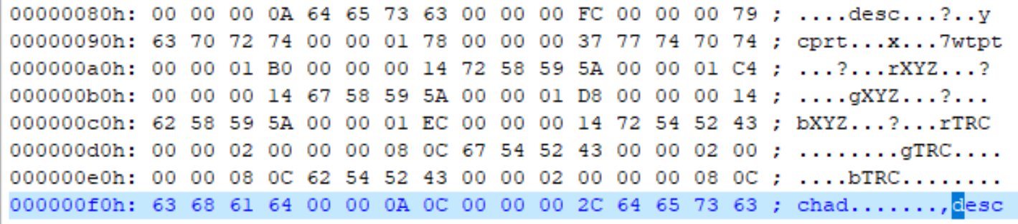
Sampe: SE2722HR Tag table
Tag count: 10
Tag: desc, cprt, wtpt, rXYZ, gXYZ, bXYZ, rTRC, gTRC, bTRC, chad

Slide 21
Sampe: SE2722HR Tag & Data
‘desc’, profileDescriptionTag, “DELL SE2722HR Color Profile,D6500”
‘cptr’, copyrightTag, “text”-0x0-”Copyright (c) 2022 Dell Inc”
‘wtpt’, mediaWhitePointTag, XYZ, value same as PCS nCIEXYZ)
0xF6D6-0x10000-0xD32D
‘rXYZ’, redMatrixColumnTag, XYZ, 0x6E77-0x3880-0x01B1
0.43150-0.22070-0.00661
‘gXYZ’, XYZ, 0x6412-0xB8FC-0x1234
‘bXYZ’, XYZ, 0x2454-0x0E8A-0xBF56

Slide 22
Sampe: SE2722HR Tag & Data
rTRC-gTRC-bTRC, offset 0x200, size 0x80C,
curveType, curveCount 0x400 (1024 curveValue),
chad, chromaticAdaptationTag, sf32,
[ 10C44, 5DF, FFFFF326
794, FD8F, FFFFFBA1
FFFFFDA2, 3DB, C075]

Slide 23
Sampe: 7091
Dell Laptop Monitor
Dell_Inspiron_15_7510_UHD_AUO7091.icm

Slide 24
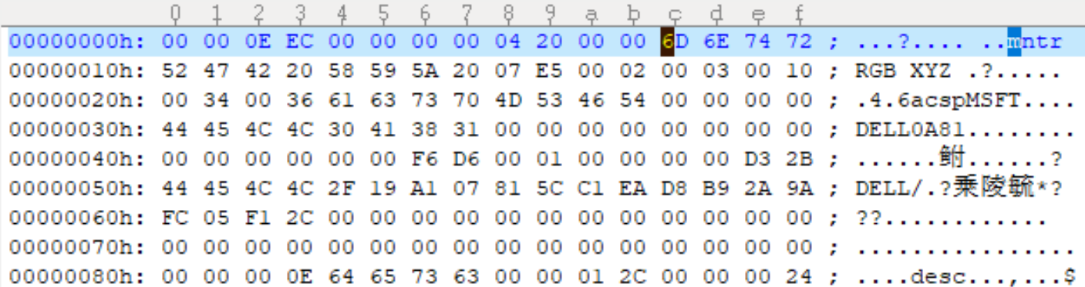
Sampe: 7091 Header
Size: 3820, Ver: 4.32, Profile class: Display, RGB->XYZ,
Date/Time: 2021/2/3 16:52:54, Device model field: 0A81,
PCS illuminant: 0xF6D6-0x10000-0xD32D,
Profile ID field: header MD5 (16 Bytes)

Slide 25
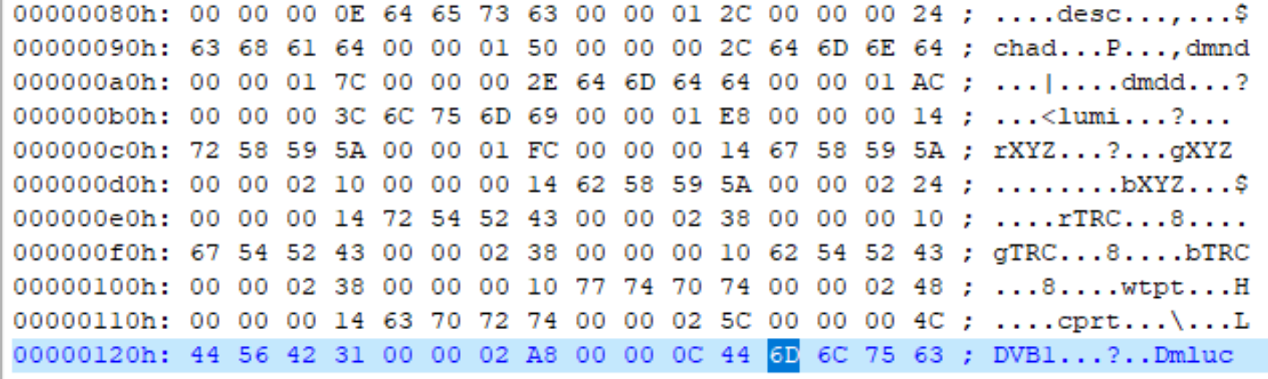
Sampe: 7091 Tag list
Tag count: 14
Tag: desc, cprt, wtpt, rXYZ, gXYZ, bXYZ, rTRC, gTRC, bTRC, chad, dmnd x2, lumi, DVB1(no describe in this spec ver4.3)

Slide 26
Sampe: 7091 chad
[ 10C3E, 5D0, FFFFF32F
791, FD8E, FFFFFBA4
FFFFFDA5, 3D9, C090]

